Slide 2
Introduction au TD NGS pour la cancérologie
Dr Elodie Darbo, U1218 ACTION, elodie.darbo@u-bordeaux.fr

Slide 3
Télécharger le support TD
https://tinyurl.com/NGSClass2021

Slide 4
Plan général sur les 8h de TD
Session 1 (3h)
Installation des packages R
Introduction des bases en cancérologie
Présentation du contexte du TD et introduction aux analyses NGS
TD partie 1: Traitement primaire des données NGS
Session 2 (3h)
TD partie 2: Recherche de variants et classification de patients
TD partie 3: Analyse différentielle du transcriptome et annotations fonctionnelles

Slide 5
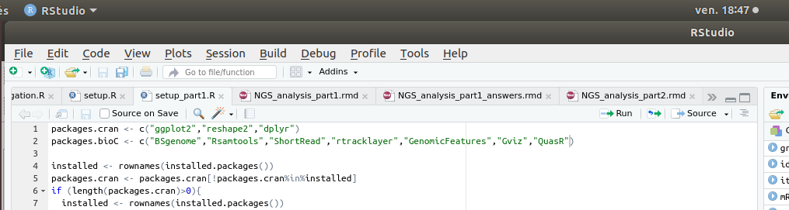
Installation des packages
Dans le dossier téléchargé vous trouverez le dossier scripts
Ouvrez setup_part1.R dans RStudio
Appuyez sur Source: ceci va lire tout le fichier et procéder aux installations

Slide 6
Pendant que ça installe … Introduction générale
Qu’est ce qu’un cancer ?
Apport des Next Generation Sequencing (NGS)
Pipeline de traitement des données
Présentation du TD

Slide 7
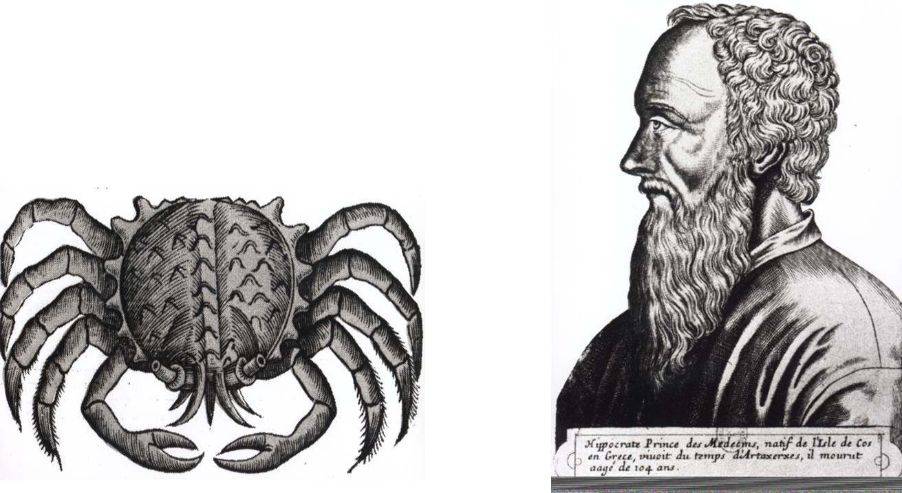
Qu’est ce qu’un cancer ?
Histoire
460 avant JC: Hippocrate nomme cette maladie “karcinos” (crabe) en analogie entre les ramifications des cellules cancéreuses et les pinces de crabe.

Slide 8
Qu’est ce qu’un cancer ?
Histoire
460 avant JC: Hippocrate nomme cette maladie “karcinos” (crabe) en analogie entre les ramifications des cellules cancéreuses et les pinces de crabe.
Incidence
En 2018 en France: ~382 000 nouveaux cas / ~157 000 décès (source: https://www.santepubliquefrance.fr/maladies-et-traumatismes/cancers)

Slide 9
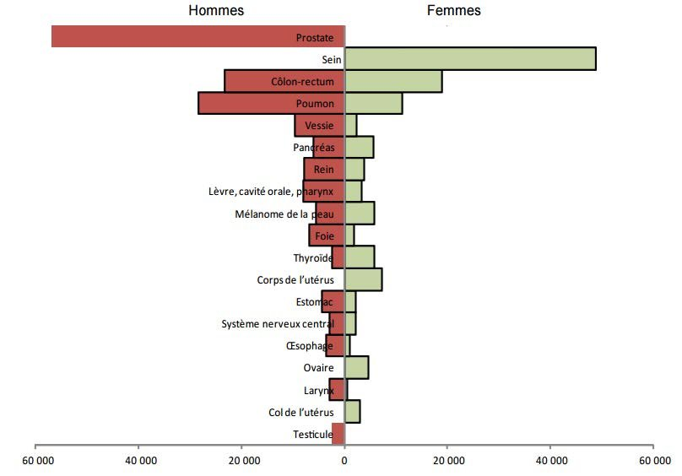
Incidence des cancers en France (2012)
Muller, Marianna. (2017). Les ADN tumoraux circulants et leur rôle dans les cancers colorectaux métastatiques : application en théranostique.

Slide 10
Qu’est ce qu’un cancer ?
Histoire
460 avant JC: Hippocrate nomme cette maladie “karcinos” (crabe) en analogie entre les ramifications des cellules cancéreuses et les pinces de crabe.
Incidence
En 2018 en France: ~382 000 nouveaux cas / ~157 000 décès (source: https://www.santepubliquefrance.fr/maladies-et-traumatismes/cancers)
Définition
Amas de cellules immortelles (tumeur) se divisant anarchiquement qui altère le fonctionnement de l’organe où il se situe et peut se propager via le système sanguin ou lymphatique → métastases

Slide 11
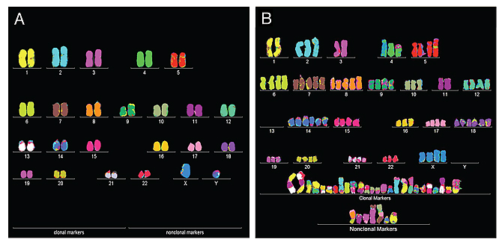
Qu’est ce qu’un cancer ?
Un caryotype anormal: cellule normale (à gauche) et cancéreuse (cancer de la vessie) à droite,obtenus avec la technique de FISH
https://www.berkeley.edu/
De nombreuses anomalies apparaissent dans les cellules cancéreuses: nombre de chromosomes en plus ou en moins, translocations, délétions...La cellule cancéreuse a accumulé des mutations et des anomalies de la répartition des chromosomes

Slide 12
Les mutations acquises ou somatiques
mutations ponctuelles silencieuses (polymorphismes): sans conséquence dans la plupart des cas.
mutations ponctuelles délétères: conséquences sur l’expression des gènes, la conformation des protéines (troncage, changement d’acide aminé)
variations structurales: délétions / duplications de gènes / régions entiers ou translocations (échanges) de chromosome ou de parties de chromosome qui peut mener à des fusion de gènes.

Slide 13
Acquisition des mutations
Risques endogènes: à chaque division cellulaire l’ADN est répliqué, des erreurs peuvent-être introduites
ADN: 3x10⁹ nucléotides
taux de mutation: ~ 10⁻⁸ → ~ 100 mutations / cycle cellulaire
> 1 milliard divisions cellulaires / jour (remplacement de cellules vieillissantes ou endommagées)
Risques exogènes: tabac, alcool, soleil, polluants, virus etc …
Heureusement les cellules ont des mécanismes de réparation ou d’induction de leur mort (apoptose) contrôlés par des gènes.

Slide 14
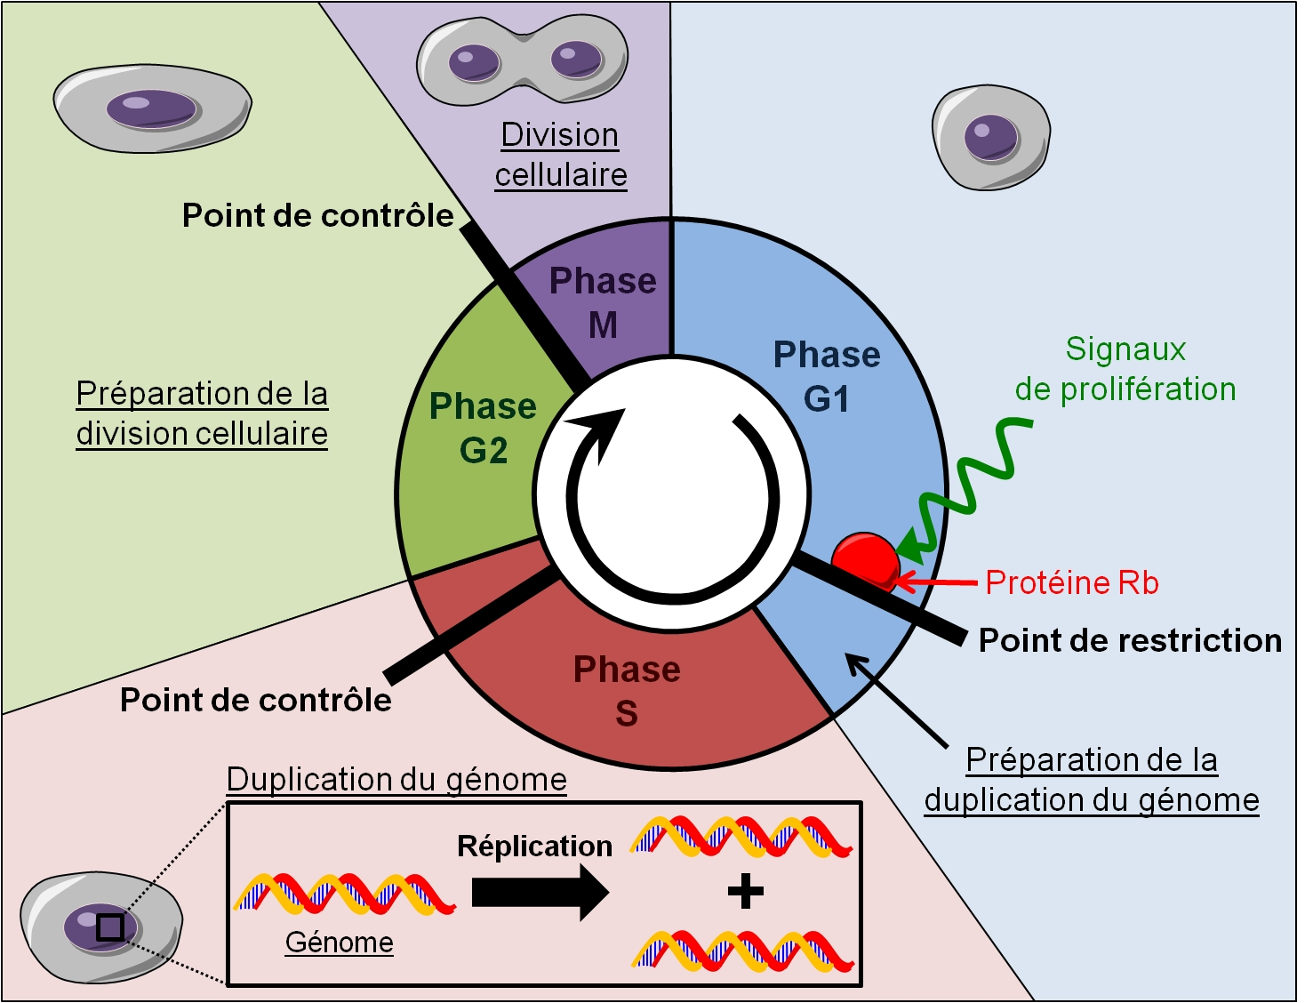
Le cycle cellulaire
http://gregynours.e-monsite.com/pages/comment-apparait-une-cellule-cancereuse.html
Notes:
Des points de contrôle sont programmés entre chaque phase du cycle cellulaire, afin de vérifier que le processus en cours se déroule de façon normale. Pendant la phase S, des mutations spontanées ou induites par des produits chimiques ou des radiations ionisantes ou tout autre agent appelé « mutagène » peuvent se produire.

Slide 15
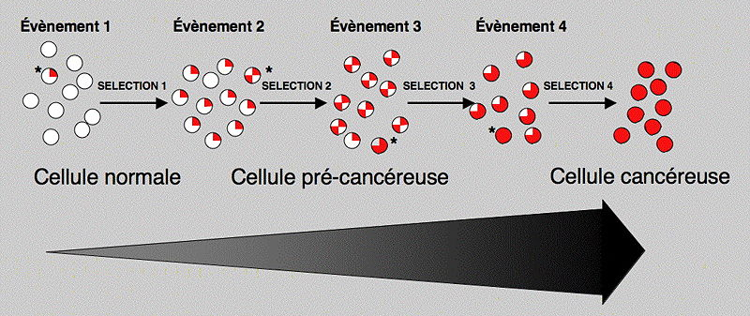
Transformation des cellules
Dans de rares cas les mutations peuvent atteindre un gène réparateur ou contrôlant la multiplication cellulaire
http://fr.wikipedia.org/wiki/Fichier:Multi_Onco.jpg
Processus long qui peut prendre plusieurs années
Notes:
Si ces mutations ne sont pas létales ou ne sont pas réparées pendant la phase G2, elles seront transmises aux cellules filles. L'accumulation d'erreurs non létales dans le génome de la cellule est à l'origine de la TRANSFORMATION de la cellule, à l'origine saine, en cellule cancéreuse.

Slide 16
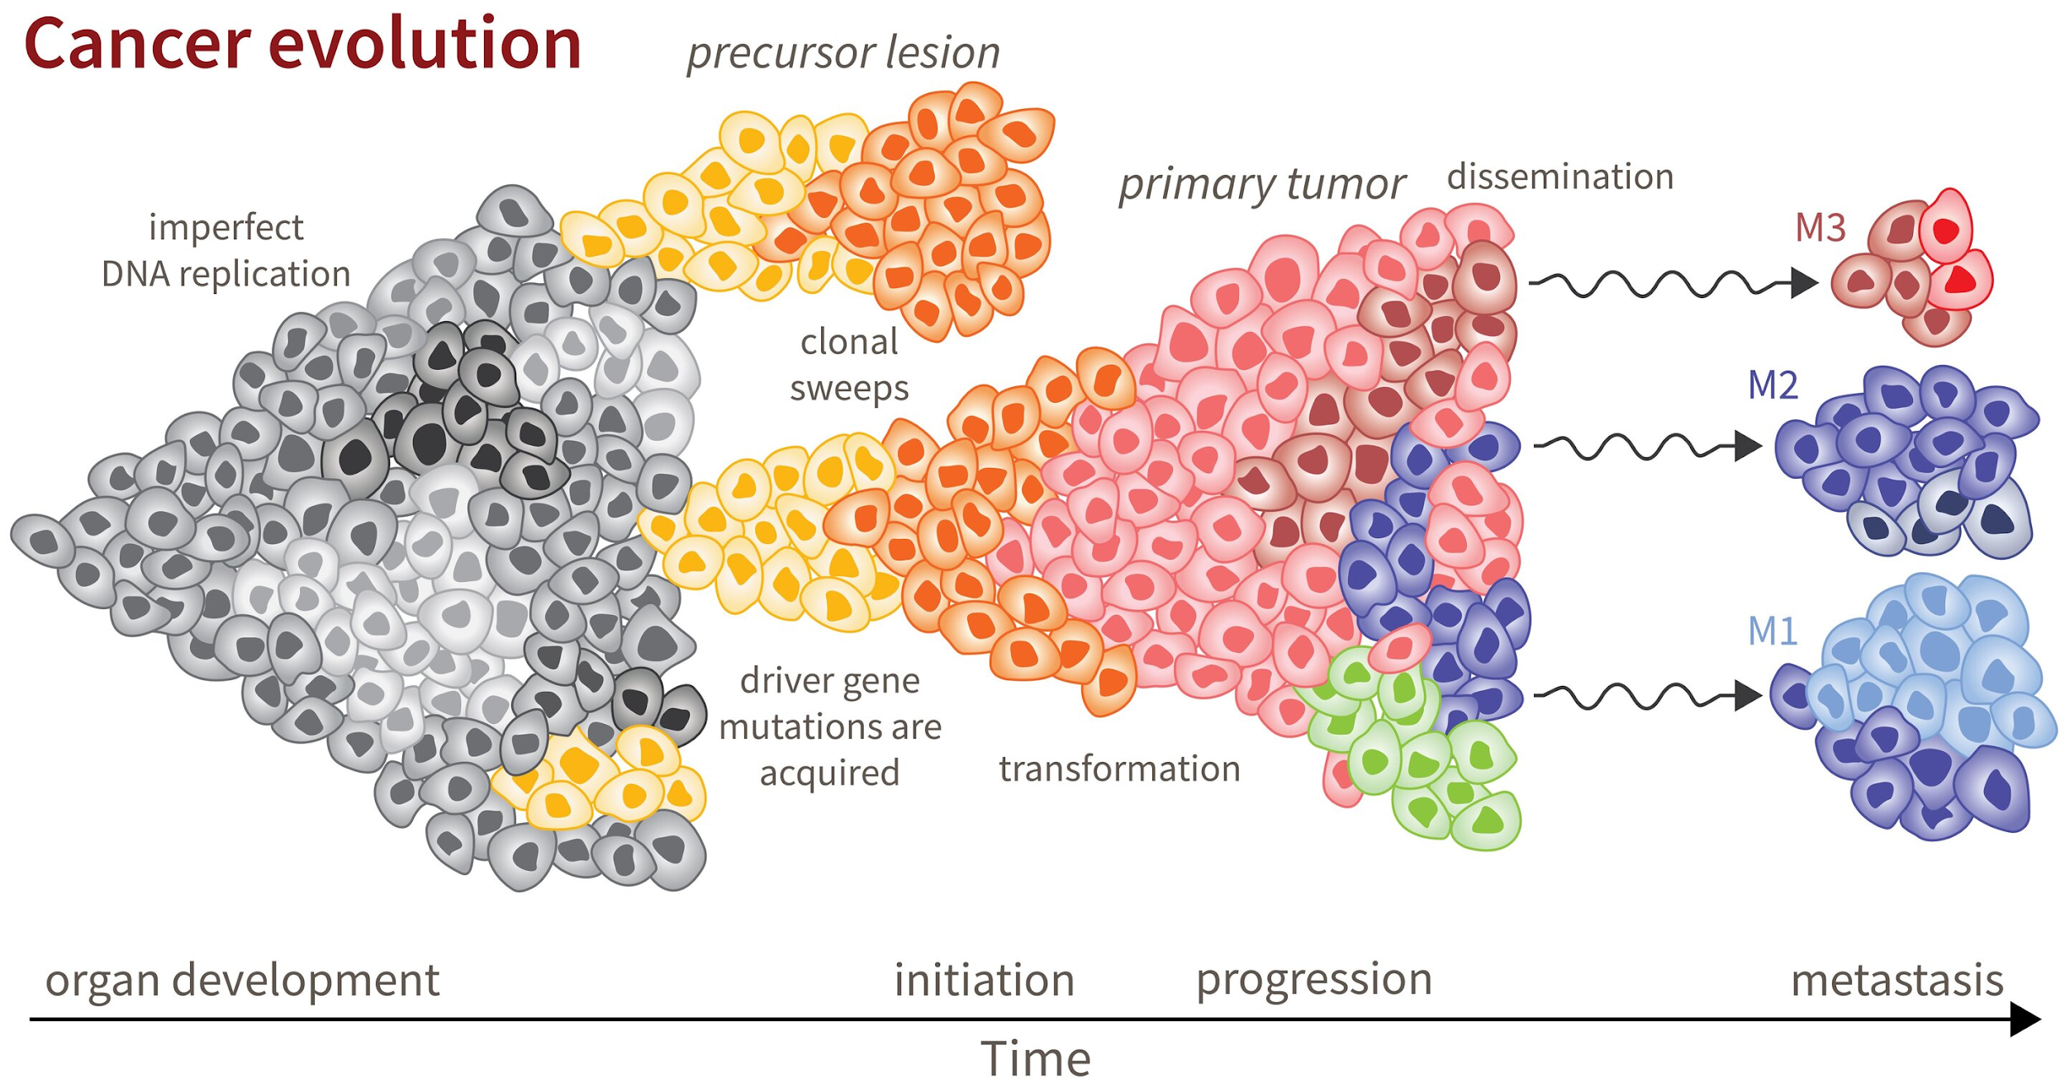
Evolution du cancer
Reiter Lab

Slide 17
Les gènes impliqués dans la cancérogenèse
La cellule reçoit en permanence des signaux chimiques des autres cellules qui peuvent lui ordonner de se diviser, de se reposer ou de s’autodétruire.
proto-oncogènes: normaux et indispensables, transmettent les signaux mitotiques → mutation → oncogènes → stimulation incontrôlée des divisions cellulaires
suppresseurs de tumeur: freinent la prolifération des cellules (i.e. gène P53 muté dans >60% des cancers) → mutation → inactivation ou une diminution de leur fonctionnement → stimulation anormale de la prolifération cellulaire
réparateurs de l’ADN → mutation → favorisent l'apparition des cancers.

Slide 18
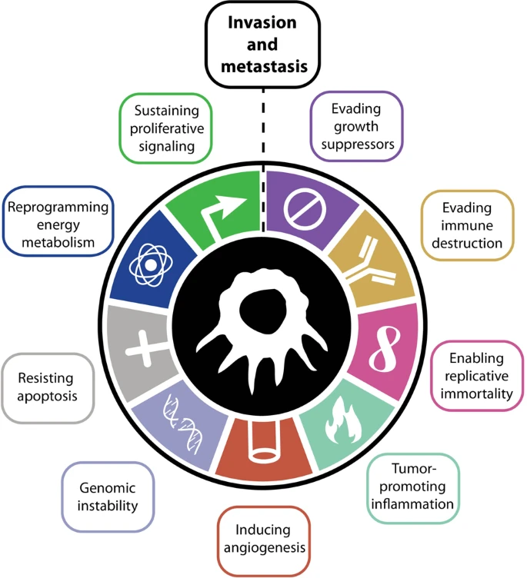
Caractéristiques d’une cellule cancéreuse
son indépendance vis-à-vis des signaux qui régulent (favorisent ou freinent) habituellement sa croissance et sa division
sa capacité à échapper au processus de mort cellulaire programmée
sa capacité à se diviser indéfiniment
The hallmarks of cancer
Meirson, T., Gil-Henn, H. & Samson, A.O. Invasion and metastasis: the elusive hallmark of cancer. Oncogene 39, 2024–2026 (2020)

Slide 19
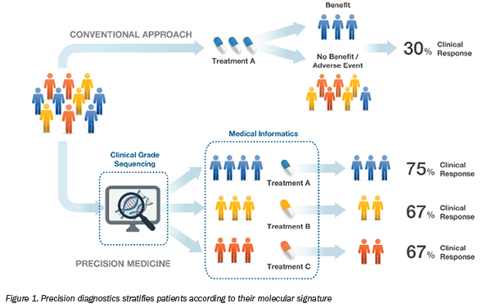
Challenge: détecter les mutations promotrices
(marqueurs moléculaires)
https://www.asiabiotech.com/22/2211/22110016x.html

Slide 20
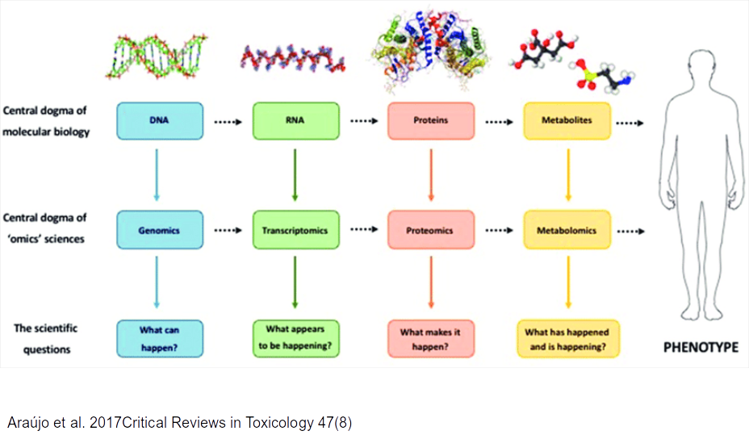
L’utilité des données Next Generation Sequencing (NGS)

Slide 21
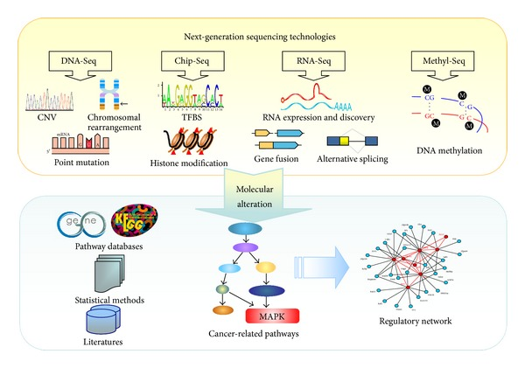
L’utilité des données Next Generation Sequencing (NGS)
Chen J, Zhang D, Yan W, Yang D, Shen B. Translational bioinformatics for diagnostic and prognostic prediction of prostate cancer in the next-generation sequencing era. Biomed Res Int. 2013

Slide 22
Vue d’ensemble d’un projet
Biological question
E
Experimental design
Library preparation
Sequencing
P1
Raw data
Quality assessment
Mapping
P2
Variant calling
RNA counting
Genomic occupancy
Interaction calling
A
Statistical / mathematical modelling
Visualisation
Functional annotation

Slide 23
Présentation du TD
Contexte biologique:
Les léiomyosarcomes (LMS) sont des cancers des tissus mous
montrant une différenciation musculaire lisse
se trouvant à de multiples endroits du corps
Aucun marqueur génétique ne permet de les identifier systématiquement
Il n’existe pas de thérapie ciblée
Génétique complexe inexpliquée
Seules les voies de signalisation Rb1 et TP53 ont été identifiée
N’explique pas tous les phénotypes tumoraux

Slide 24
Ce qu’on va faire sur l’ensemble du TD
Manipuler des fichiers de données NGS de différents types:
Fastq
Bam
Utiliser RStudio
Utilisation de commandes basiques et avancées
Suivre un pipeline d’analysis
Utiliser les NGS pour comprendre un phénotype
Recherche de variants structuraux
Classification des patients
Recherche de gènes différentiellement exprimés et de voies de signalisation dérégulées

Slide 25
Objectifs
Comprendre les principes derrière une analyse NGS
Que veut dire qualité ?
Quelles sont les étapes importantes ?
Des 100aines de paramètres qui peuvent changer les résultats
NO MAGIC !
Comprendre l’intérêt des NGS et de leur analyse pour la cancérologie

Slide 26
TD partie 1: étapes
Biological question
E
Experimental design
Library preparation
Sequencing
P1
Raw data
Quality assessment
Mapping
P2
Variant calling
RNA counting
Genomic occupancy
Interaction calling
A
Statistical / mathematical modelling
Visualisation
Functional annotation

Slide 27
TD partie 1: étapes
Biological question
E
Experimental design
Library preparation
Sequencing
P1
Raw data
Quality assessment
Mapping
P2
Variant calling
RNA counting
Genomic occupancy
Interaction calling
A
Statistical / mathematical modelling
Visualisation
Functional annotation

Slide 28
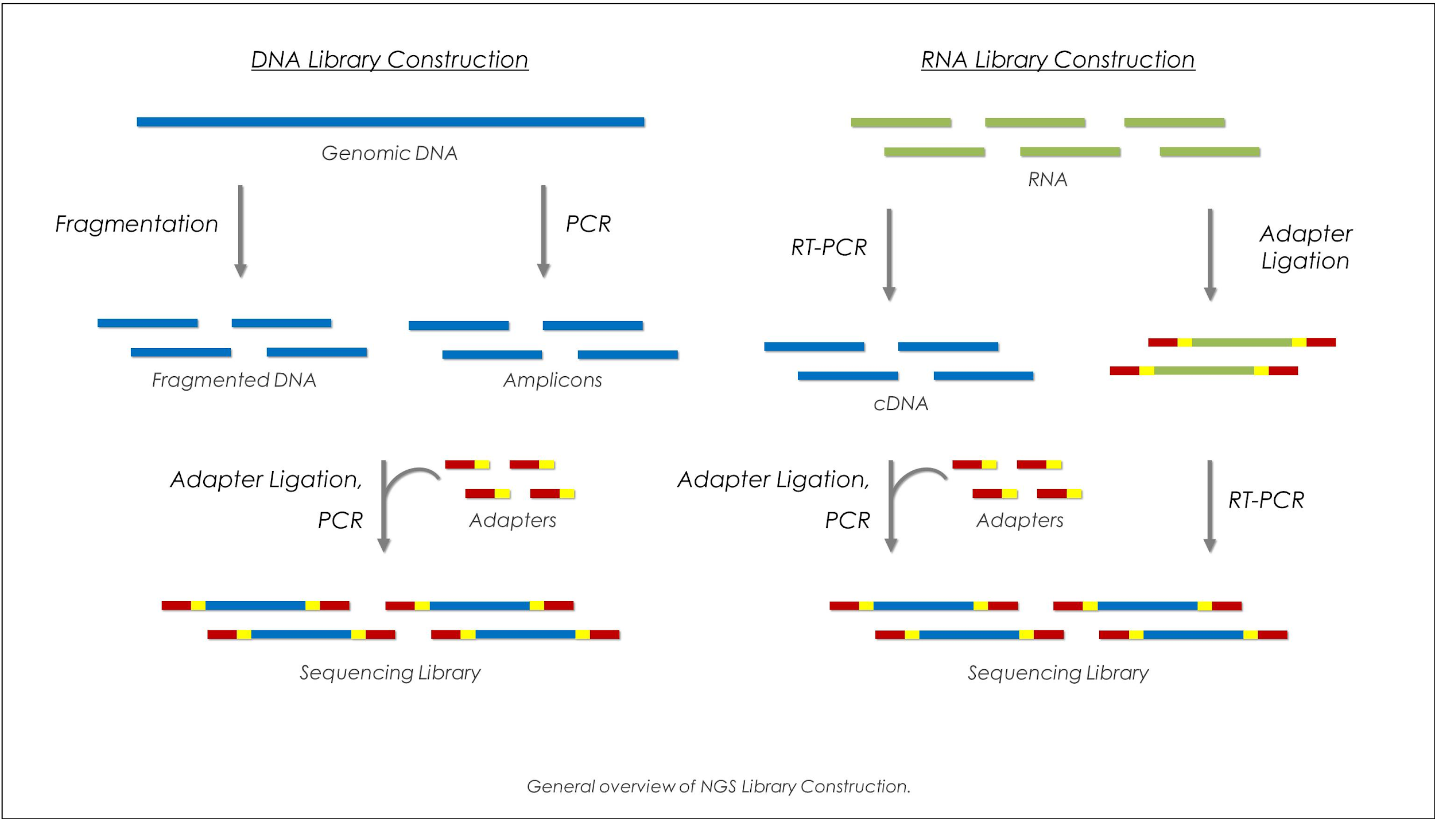
Production des données NGS
https://www.biocompare.com/Molecular-Biology/9187-Next-Generation-Sequencing/

Slide 29
TD partie 1: étapes
Biological question
E
Experimental design
Library preparation
Sequencing
P1
Raw data
Quality assessment
Mapping
P2
Variant calling
RNA counting
Genomic occupancy
Interaction calling
A
Statistical / mathematical modelling
Visualisation
Functional annotation

Slide 30
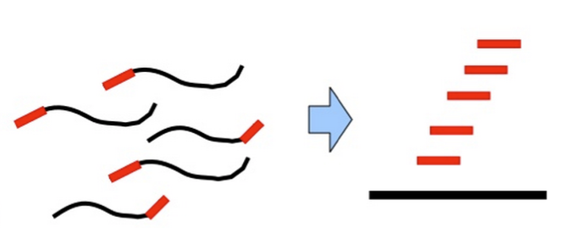
Données brutes: fastq files (.fastq ou .fq)
reads.fastq
Single-end (SE): from each cDNA fragment only one end is read
@SRR064166.142 HWI-EAS229_104:7:1:1:510 length=37/1
GCAAAATGGATCCGTAACTTCGGGAAAAGGATTGGCT
+
BB@?4@B@BAB@6@?B6AB@;)>*3/:2BB4B#####

Slide 31
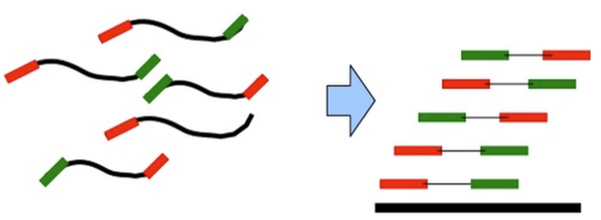
Données brutes: fastq files (.fastq ou .fq)
reads.fastq
Single-end (SE): from each cDNA fragment only one end is read
@SRR064166.142 HWI-EAS229_104:7:1:1:510 length=37/1
GCAAAATGGATCCGTAACTTCGGGAAAAGGATTGGCT
+
BB@?4@B@BAB@6@?B6AB@;)>*3/:2BB4B#####
Reads_PE.fastq
@SRR064166.152 HWI-EAS229_104:7:1:1:1001 length=37/1
GTTTAAGCATATCAATAAGCGGAGGAACAGACACTAA
+
BBCB>ACBABCCCA;BB5)>C5,.B6<1>C<1<6?CC
@SRR064166.152 HWI-EAS229_104:7:1:1:1001 length=37/2
CGACTTCCCTTGCCTACATTGTTCCATCGACCAGAGG
+
BBCBBCABBBBBBBCA=BAA<AC=;@CA;?BB@5>##
Paired-end (PE): the cDNA fragment is read from both ends

Slide 32
Données brutes: fastq files (.fastq ou .fq)
reads.fastq
Single-end (SE): from each cDNA fragment only one end is read
@SRR064166.142 HWI-EAS229_104:7:1:1:510 length=37/1
GCAAAATGGATCCGTAACTTCGGGAAAAGGATTGGCT
+
BB@?4@B@BAB@6@?B6AB@;)>*3/:2BB4B#####
reads_R1.fastq
@SRR064166.152 HWI-EAS229_104:7:1:1:1001 length=37
GTTTAAGCATATCAATAAGCGGAGGAACAGACACTAA
+
BBCB>ACBABCCCA;BB5)>C5,.B6<1>C<1<6?CC
Paired-end (PE): the cDNA fragment is read from both ends
reads_R2.fastq
@SRR064166.152 HWI-EAS229_104:7:1:1:1001 length=37
CGACTTCCCTTGCCTACATTGTTCCATCGACCAGAGG
+
BBCBBCABBBBBBBCA=BAA<AC=;@CA;?BB@5>##

Slide 33
Données brutes: fastq files (.fastq ou .fq)
sequence identifier
@SRR064166.142 HWI-EAS229_104:7:1:1:510 length=37/1
GCAAAATGGATCCGTAACTTCGGGAAAAGGATTGGCT
+
BB@?4@B@BAB@6@?B6AB@;)>*3/:2BB4B#####
sequence (IUPAC nomenclature)
sequencing quality (ASCII encoding)
Correspond à un nombre qui peut être traduit en probabilité p que la base ait été mal appelée
Phred Quality Score Q | Probability of incorrect base call P | Base call accuracy
10 | 1 in 10 | 90%
20 | 1 in 100 | 99%
30 | 1 in 1000 | 99.9%
40 | 1 in 10,000 | 99.99%
50 | 1 in 100,000 | 99.999%
60 | 1 in 1,000,000 | 99.9999%
Q = - 10 log₁₀ p

Slide 34
TD partie 1: étapes
Biological question
E
Experimental design
Library preparation
Sequencing
P1
Raw data
Quality assessment
Mapping
P2
Variant calling
RNA counting
Genomic occupancy
Interaction calling
A
Statistical / mathematical modelling
Visualisation
Functional annotation

Slide 35
Qualité du séquençage: analyse d’un résultat fastQC
C’est la première étape et elle est essentielle.
Checklist:
Format de fichier: statistiques basiques
Fiabilité du base calling: Score qualité par base / par séquence
Problème transitoire avec le run: Faible qualité dans les cellules
Contamination: Contenu des séquences par base, séquences sur-représentées
Quelques outils:
FastQC (http://www.bioinformatics.babraham.ac.uk/projects/fastqc/)
R/Bioconductor ShortRead package (fonctions qa() et report())
R/Bioconductor QuasR package (fonction qQCReport())

Slide 36
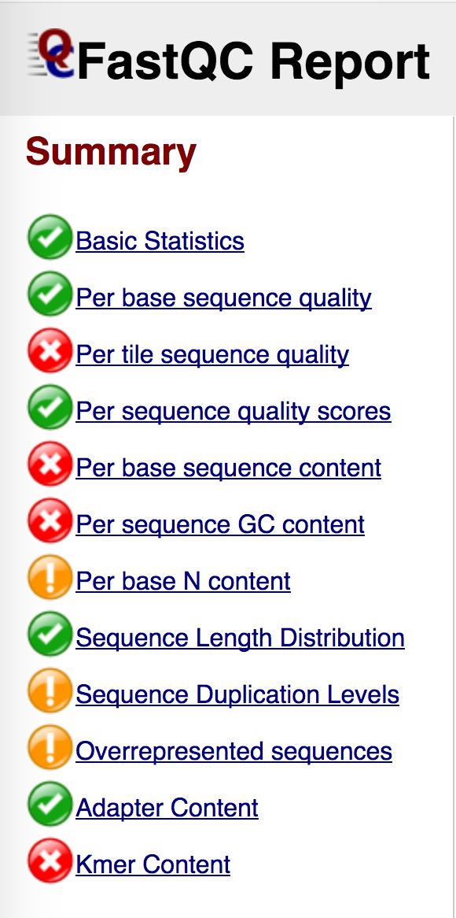
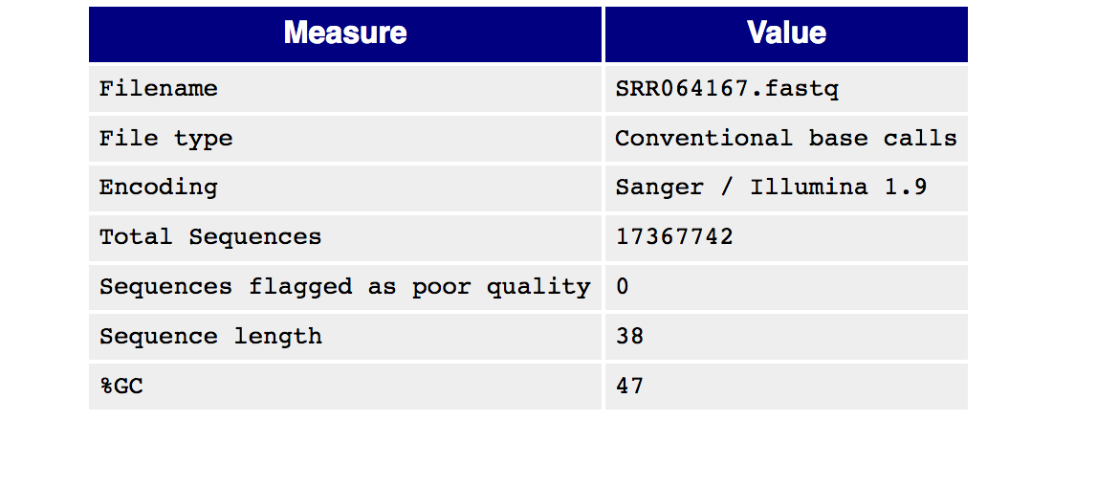
File format
File format
Notes:
Filename: The original filename of the file which was analysed
File type: Says whether the file appeared to contain actual base calls or colorspace data which had to be converted to base calls
Encoding: Says which ASCII encoding of quality values was found in this file.
Total Sequences: A count of the total number of sequences processed. There are two values reported, actual and estimated. At the moment these will always be the same. In the future it may be possible to analyse just a subset of sequences and estimate the total number, to speed up the analysis, but since we have found that problematic sequences are not evenly distributed through a file we have disabled this for now.
Filtered Sequences: If running in Casava mode sequences flagged to be filtered will be removed from all analyses. The number of such sequences removed will be reported here. The total sequences count above will not include these filtered sequences and will the number of sequences actually used for the rest of the analysis.
Sequence Length: Provides the length of the shortest and longest sequence in the set. If all sequences are the same length only one value is reported.
%GC: The overall %GC of all bases in all sequences

Slide 37
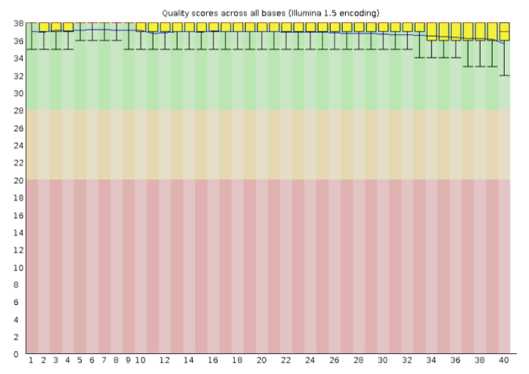
Reliability of base calling (per base)
Quality score:
The higher the better
Quality of calls from most platforms will degrade as the run processes
Quality score
Position in read (bp)
Warning: if the lower quartile for any base is less than 10, or if the median for any base is less than 25.
Failure: if the lower quartile for any base is less than 5 or if the median for any base is less than 20.
Notes:
so it is common to see base calls falling into the orange area towards the end of a read.

Slide 38
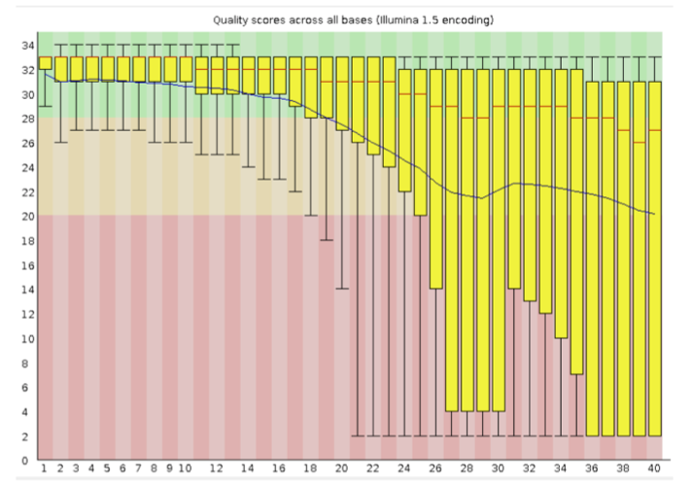
Reliability of base calling (per base)
GOOD
POOR
Quality score
Position in read (bp)
Position in read (bp)

Slide 39
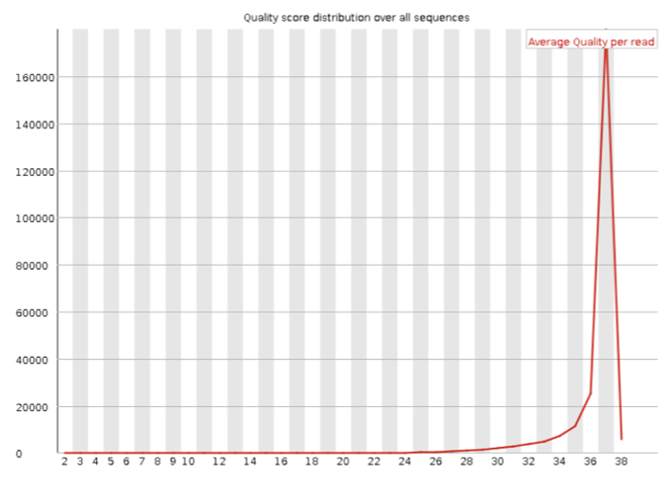
Reliability of base calling (per sequence)
Reliability of base calling (per sequence)
The per sequence quality score report allows you to see if a subset of your sequences have universally low quality values.
Warning: if the most frequently observed mean quality is below 27
- this equates to a 0.2% error rate.
Failure: if the most frequently observed mean quality is below 20
- this equates to a 1% error rate.

Slide 40
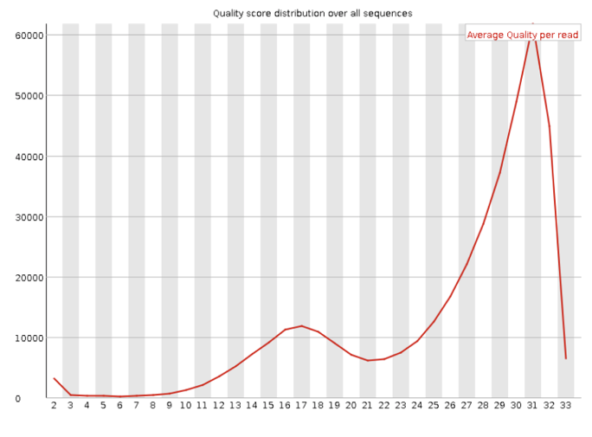
Reliability of base calling (per sequence)
Reliability of base calling (per sequence)
GOOD
POOR

Slide 41
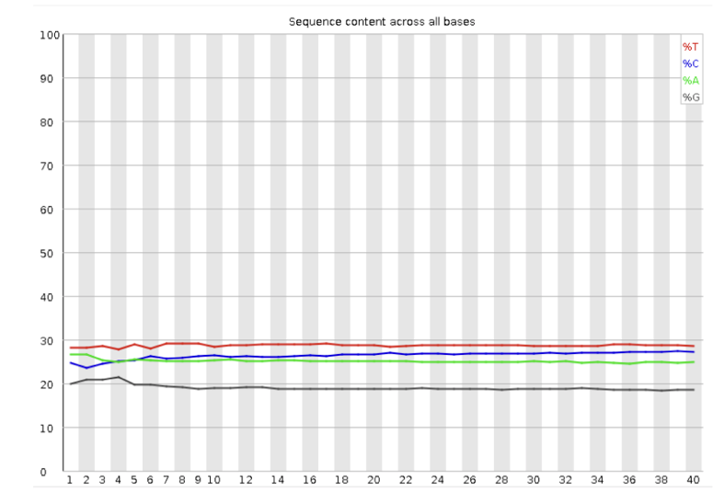
Contamination: per base sequence content
Contamination: per base sequence content
In a random library you would expect no difference between the different bases
Warning: if the difference between A and T, or G and C is greater than 10% in any position. Failure: if the difference between A and T, or G and C is greater than 20% in any position.
Notes:
Common reasons for warnings
There are a number of common scenarios which would ellicit a warning or error from this module.
Overrepresented sequences: If there is any evidence of overrepresented sequences such as adapter dimers or rRNA in a sample then these sequences may bias the overall composition and their sequence will emerge from this plot.
Biased fragmentation: Any library which is generated based on the ligation of random hexamers or through tagmentation should theoretically have good diversity through the sequence, but experience has shown that these libraries always have a selection bias in around the first 12bp of each run. This is due to a biased selection of random primers, but doesn't represent any individually biased sequences. Nearly all RNA-Seq libraries will fail this module because of this bias, but this is not a problem which can be fixed by processing, and it doesn't seem to adversely affect the ablity to measure expression.
Biased composition libraries: Some libraries are inherently biased in their sequence composition. The most obvious example would be a library which has been treated with sodium bisulphite which will then have converted most of the cytosines to thymines, meaning that the base composition will be almost devoid of cytosines and will thus trigger an error, despite this being entirely normal for that type of library
If you are analysing a library which has been aggressivley adapter trimmed then you will naturally introduce a composition bias at the end of the reads as sequences which happen to match short stretches of adapter are removed, leaving only sequences which do not match. Sudden deviations in composition at the end of libraries which have undergone aggressive trimming are therefore likely to be spurious.

Slide 42
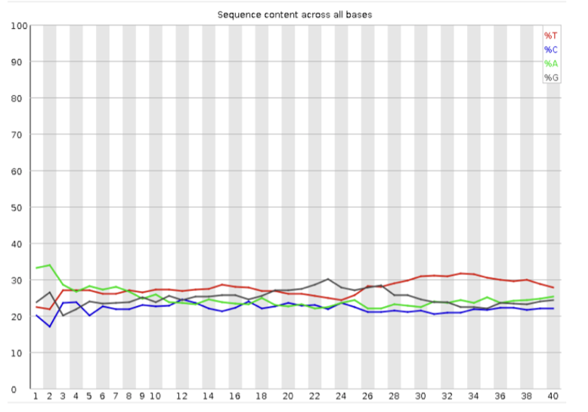
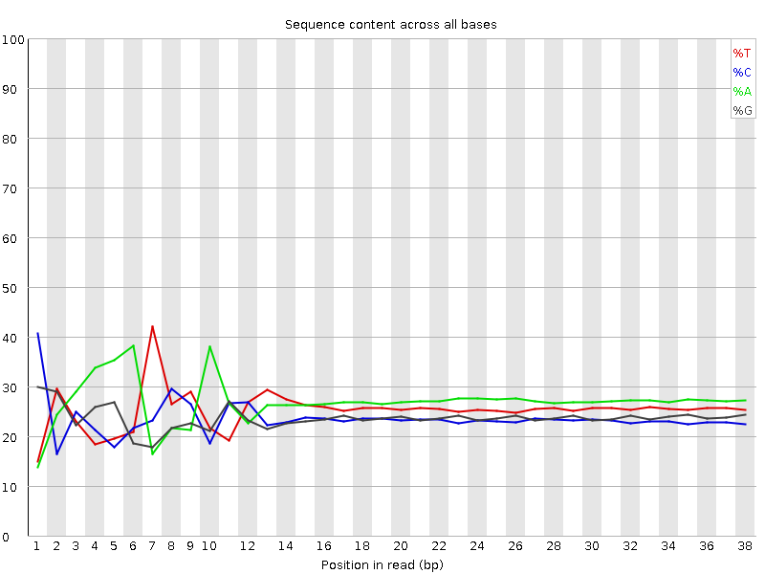
Contamination: per base sequence content
Contamination: per base sequence content
GOOD
POOR
GOOD – RNA-seq
biased selection of random primers
Notes:
Common reasons for warnings
There are a number of common scenarios which would ellicit a warning or error from this module.
Overrepresented sequences: If there is any evidence of overrepresented sequences such as adapter dimers or rRNA in a sample then these sequences may bias the overall composition and their sequence will emerge from this plot.
Biased fragmentation: Any library which is generated based on the ligation of random hexamers or through tagmentation should theoretically have good diversity through the sequence, but experience has shown that these libraries always have a selection bias in around the first 12bp of each run. This is due to a biased selection of random primers, but doesn't represent any individually biased sequences. Nearly all RNA-Seq libraries will fail this module because of this bias, but this is not a problem which can be fixed by processing, and it doesn't seem to adversely affect the ablity to measure expression.
Biased composition libraries: Some libraries are inherently biased in their sequence composition. The most obvious example would be a library which has been treated with sodium bisulphite which will then have converted most of the cytosines to thymines, meaning that the base composition will be almost devoid of cytosines and will thus trigger an error, despite this being entirely normal for that type of library
If you are analysing a library which has been aggressivley adapter trimmed then you will naturally introduce a composition bias at the end of the reads as sequences which happen to match short stretches of adapter are removed, leaving only sequences which do not match. Sudden deviations in composition at the end of libraries which have undergone aggressive trimming are therefore likely to be spurious.

Slide 43
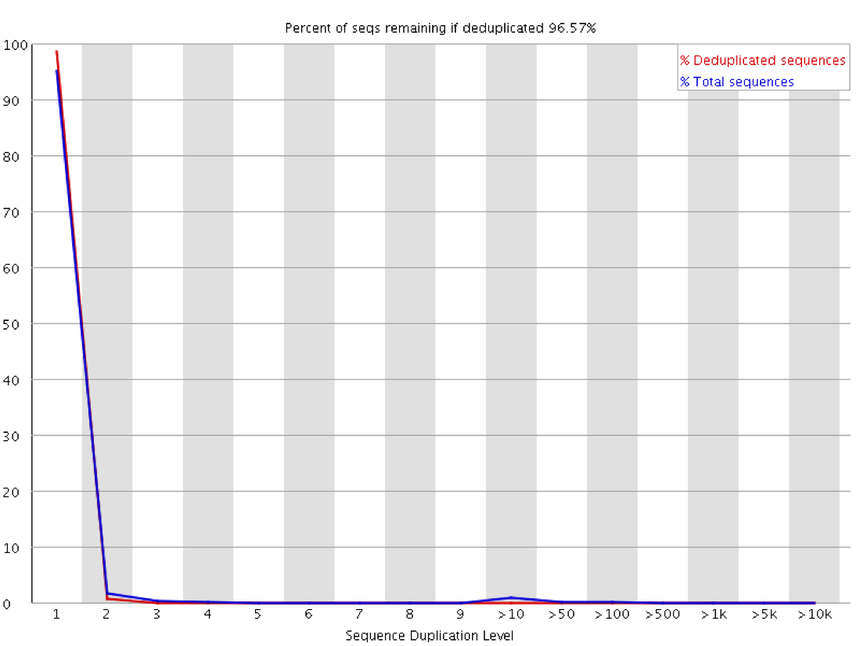
Duplication: subset enrichment
Duplication: subset enrichment
- duplication detection requires an exact sequence match over the whole length of the sequence
- biological and technical replicates can be distinguished by a system such as random barcoding
Warning: if non-unique sequences make up more than 20% of the total.
Failure: if non-unique sequences make up more than 50% of the total.
Notes:
Any reads over 75bp in length are truncated to 50bp for the purposes of this analysis.
In general there are two potential types of duplicate in a library, technical duplicates arising from PCR artefacts, or biological duplicates which are natural collisions where different copies of exactly the same sequence are randomly selected. From a sequence level there is no way to distinguish between these two types and both will be reported as duplicates here.
A warning or error in this module is simply a statement that you have exhausted the diversity in at least part of your library and are re-sequencing the same sequences. In a supposedly diverse library this would suggest that the diversity has been partially or completely exhausted and that you are therefore wasting sequencing capacity. However in some library types you will naturally tend to over-sequence parts of the library and therefore generate duplication and will therefore expect to see warnings or error from this module.
In RNA-Seq libraries sequences from different transcripts will be present at wildly different levels in the starting population. In order to be able to observe lowly expressed transcripts it is therefore common to greatly over-sequence high expressed transcripts, and this will potentially create large set of duplicates. This will result in high overall duplication in this test, and will often produce peaks in the higher duplication bins. This duplication will come from physically connected regions, and an examination of the distribution of duplicates in a specific genomic region will allow the distinction between over-sequencing and general technical duplication, but these distinctions are not possible from raw fastq files. A similar situation can arise in highly enriched ChIP-Seq libraries although the duplication there is less pronounced. Finally, if you have a library where the sequence start points are constrained (a library constructed around restriction sites for example, or an unfragmented small RNA library) then the constrained start sites will generate huge duplication levels which should not be treated as a problem, nor removed by deduplication. In these types of library you should consider using a system such as random barcoding to allow the distinction of technical and biological duplicates.

Slide 44
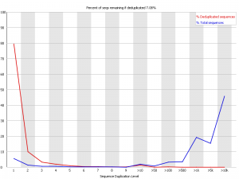
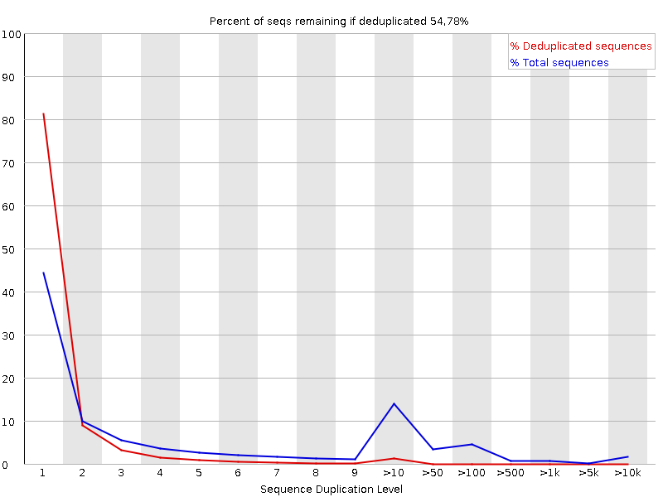
Duplication: subset enrichment
Duplication: subset enrichment
- unsaturated library sampling
- diverse population
- PCR amplification
GOOD
POOR
GOOD – RNA-seq
- constrained start points
- library over-sequencing
https://proteo.me.uk/2013/09/a-new-way-to-look-at-duplication-in-fastqc-v0-11/
Notes:
This is a good RNA-Seq library, but actually represents the kind of profile you might see in any enriched experiment. In general FastQC makes the assumption that you expect to be looking at a diverse library with a roughly even representation of all sequences. In enriched libraries this isn’t going to be true and there are certain sequences (highly expressed genes or enriched peaks in a ChIP) where you want the sequence to occur more frequently. Above a certain read density the only way to place more reads into a region is via duplication so we might not expect to have a properly diverse library.

Slide 45
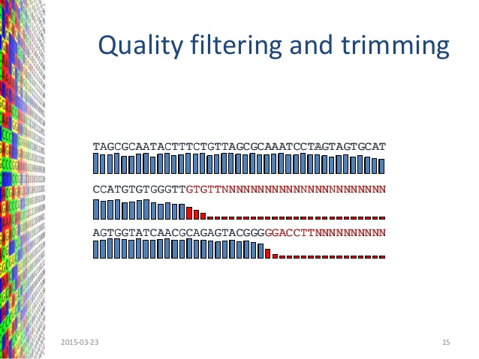
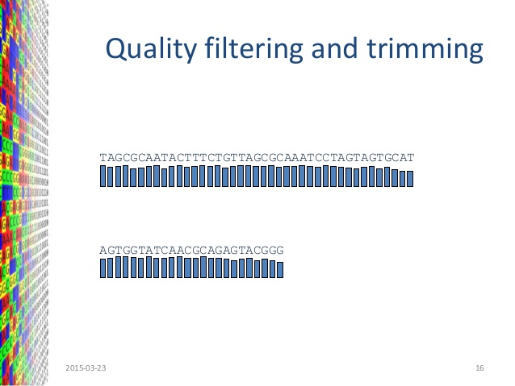
Données brutes: nettoyage
sequence identifier
@SRR064166.142 HWI-EAS229_104:7:1:1:510 length=37/1
GCAAAATGGATCCGTAACTTCGGGAAAAGGATTGGCT
+
BB@?4@B@BAB@6@?B6AB@;)>*3/:2BB4B#####
sequence (IUPAC nomenclature)
sequencing quality (ASCII encoding)
Quality assessment
FastQC
Data cleaning
https://www.slideshare.net/andrzejsczech/introduction-to-bioinformatics-46058494

Slide 46
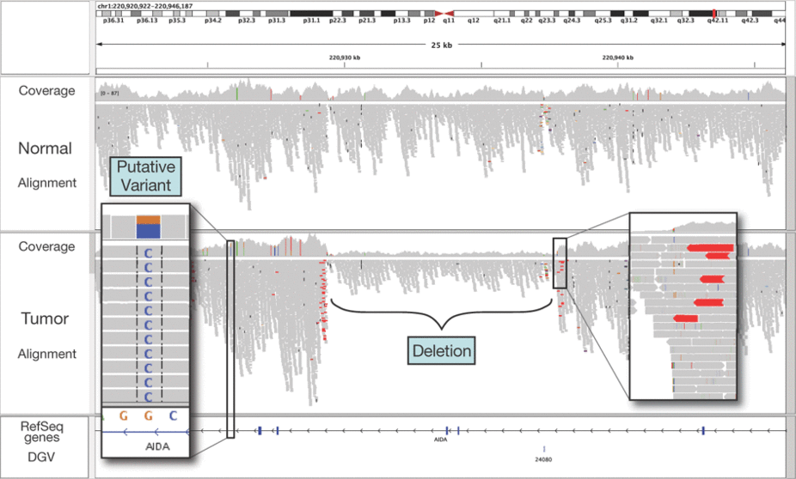
D’où proviennent les fragments séquencés?
@SRR064166.142 HWI-EAS229_104:7:1:1:510 length=37/1
GCAAAATGGATCCGTAACTTCGGGAAAAGGATTGGCT
+
BB@?4@B@BAB@6@?B6AB@;)>*3/:2BB4B#####
?
IGV http://software.broadinstitute.org/software/igv/
Robinson et al.. Nature Biotechnology (2011)

Slide 47
TD partie 1: étapes
Biological question
E
Experimental design
Library preparation
Sequencing
P1
Raw data
Quality assessment
Mapping
P2
Variant calling
RNA counting
Genomic occupancy
Interaction calling
A
Statistical / mathematical modelling
Visualisation
Functional annotation

Slide 48
Alignement sur référence

Slide 49
Reference genome/transcriptome available
Alignement sur un génome de référence
Alignement
read
CTGGTCGGATGCG
reference
… GCCGGCGATGCGTCCTGGTCGGATGCGGAACGGAGCA …

Slide 50
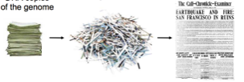
Chercher une aiguille dans une botte de foin
Alignement
read
CTGGTCGGATGCG
reference
… GCCGGCGATGCGTCCTGGTCGGATGCGGAACGGAGCA …
Pas toujours aisé
les reads sont courts ~100 bp
Le génome est immense (H. Sapien ~3,000,000,000 bp)
DNA copies of the genome
reads
assembled genome
Les reads contiennent des erreurs
(avec de la chance 1/1000 base est fausse)

Slide 51
Quelques répétitions
Alignement
read
CTGGTCGGATGCG
reference
… GCCGGCGATGCGTCCTGGTCGGATGCGGAACGGAGCA …
Pas toujours aisé
les reads sont courts ~100 bp
Le génome est immense (H. Sapien ~3,000,000,000 bp)
region 1
… GCCGGCGATGCGTCCTGGTCGGATGCGGAACGGAGCAGTAAATGCCATGGAAGAGC …
… GGTTCAGCAGGAATGCCGCTGGTCGGATGCGAGACTCAAATGAGAACTTTGAAGGCCGAC …
from where does it come from?
CTGGTCGGATGCG
read
region 2
Les reads contiennent des erreurs
(avec de la chance 1/1000 base est fausse)
Le génome contient des séquences répétées

Slide 52
Lorsqu’on étudie des échantillons tumoraux ...
Alignement
read
CTGGTCGGATGCG
reference
… GCCGGCGATGCGTCCTGGTCGGATGCGGAACGGAGCA …
local variant SNP/indels
Pas toujours aisé
les reads sont courts ~100 bp
Le génome est immense (H. Sapien ~3,000,000,000 bp)
region1
region2
region3
reference
sample
Les reads contiennent des erreurs
(avec de la chance 1/1000 base est fausse)
Le génome contient des séquences répétées
Variants structuraux et mutations ponctuelles
truncated
duplicated

Slide 53
Lorsqu’on s’intéresse au transcrits ...
Alignement
read
CTGGTCGGATGCG
reference
… GCCGGCGATGCGTCCTGGTCGGATGCGGAACGGAGCA …
Pas toujours aisé
les reads sont courts ~100 bp
Le génome est immense (H. Sapien ~3,000,000,000 bp)
paired end read
easy to align
hard to align
Gene X
Genome
exon 1
exon 2
exon 3
insert size
easy to align
paired end read
easy to align
Les reads contiennent des erreurs
(avec de la chance 1/1000 base est fausse)
Le génome contient des séquences répétées
Variants structuraux et mutations ponctuelles
Epissage
Transcriptome
mRNA from Gene X
exon 1
exon 2
exon 3
insert size
Notes:
Depth of coverage is affected by the accuracy of genome alignment algorithms and by the uniqueness or the 'mappability' of sequencing reads within a target genome.

Slide 54
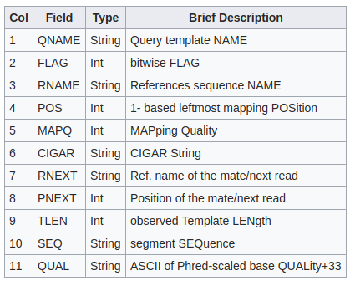
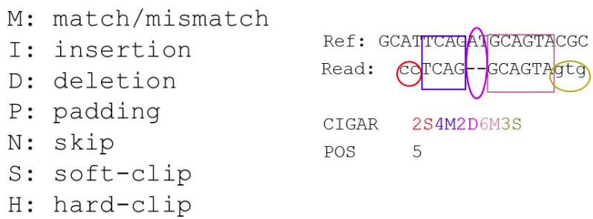
Données d’alignement: SAM / BAM format (.sam/.bam)
@HD VN:1.3 SO:coordinate
@SQ SN:ref LN:45
r001 163 ref 7 30 8M2I4M1D3M = 37 39 TTAGATAAAGGATACTG *
r002 0 ref 9 30 3S6M1P1I4M * 0 0 AAAAGATAAGGATA *
r003 0 ref 9 30 5H6M * 0 0 AGCTAA * NM:i:1
r004 0 ref 16 30 6M14N5M * 0 0 ATAGCTTCAGC *
r003 16 ref 29 30 6H5M * 0 0 TAGGC * NM:i:0
r001 83 ref 37 30 9M = 7 -39 CAGCGCCAT *
CIGAR: Concise Idiosyncratic Gapped Alignment Report (CIGAR) string
http://samtools.github.io/hts-specs/SAMv1.pdf

Slide 55
Données d’alignement: nettoyage des SAM / BAM
@HD VN:1.3 SO:coordinate
@SQ SN:ref LN:45
r001 163 ref 7 30 8M2I4M1D3M = 37 39 TTAGATAAAGGATACTG *
r002 0 ref 9 30 3S6M1P1I4M * 0 0 AAAAGATAAGGATA *
r003 0 ref 9 30 5H6M * 0 0 AGCTAA * NM:i:1
r004 0 ref 16 30 6M14N5M * 0 0 ATAGCTTCAGC *
r003 16 ref 29 30 6H5M * 0 0 TAGGC * NM:i:0
r001 83 ref 37 30 9M = 7 -39 CAGCGCCAT *
Is it uniquely mapped?

Slide 56
TD partie 1: données
Patient étudié dans le cadre de l’International Cancer Genome Consortium (ICGC) groupe Sarcome
Données brutes (fastq, sous échantillon du chr17) provenant de:
échantillon tumoral (WGS et RNA-seq)
échantillon sain (WGS)
Génome de référence et annotations des gènes (hg38)

